Slide 1
Counter Board Concept
eInk Display*
UI
Indicators / LEDs *
ESP32-WROOM-32D Dev Board
Micro SD Card Breakout *
LoRaWAN *
Battery-Backed Real Time Clock *
Wireless
WiFi
Peripherals
TFMini-Plus LIDAR Sensor Connector x2
Bluetooth / BLE
Temperature / Humidity Sensor *
Power: 5-12VDC, USB, Solar Panel
*Optional

Slide 2
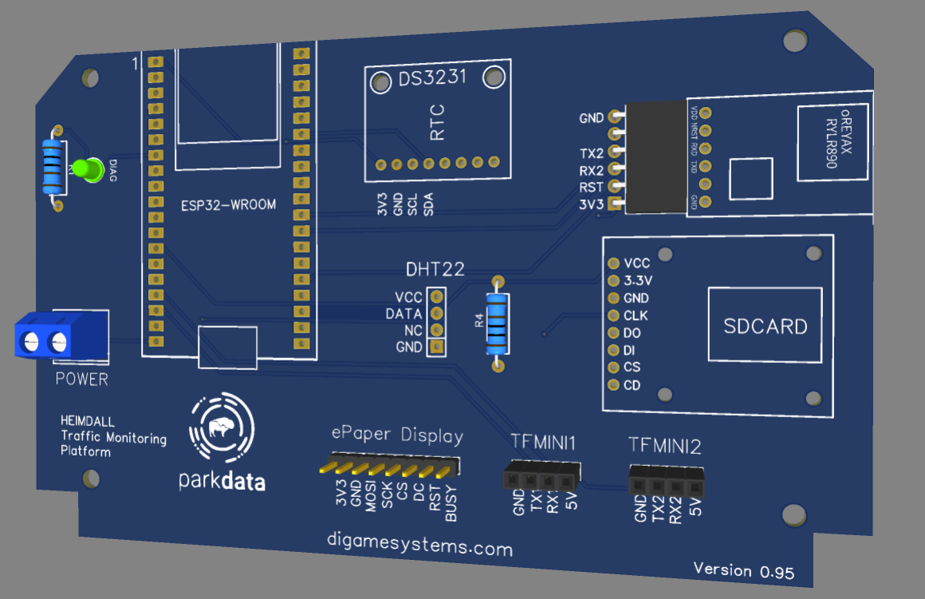
Counter Board Concept

